Slide 1
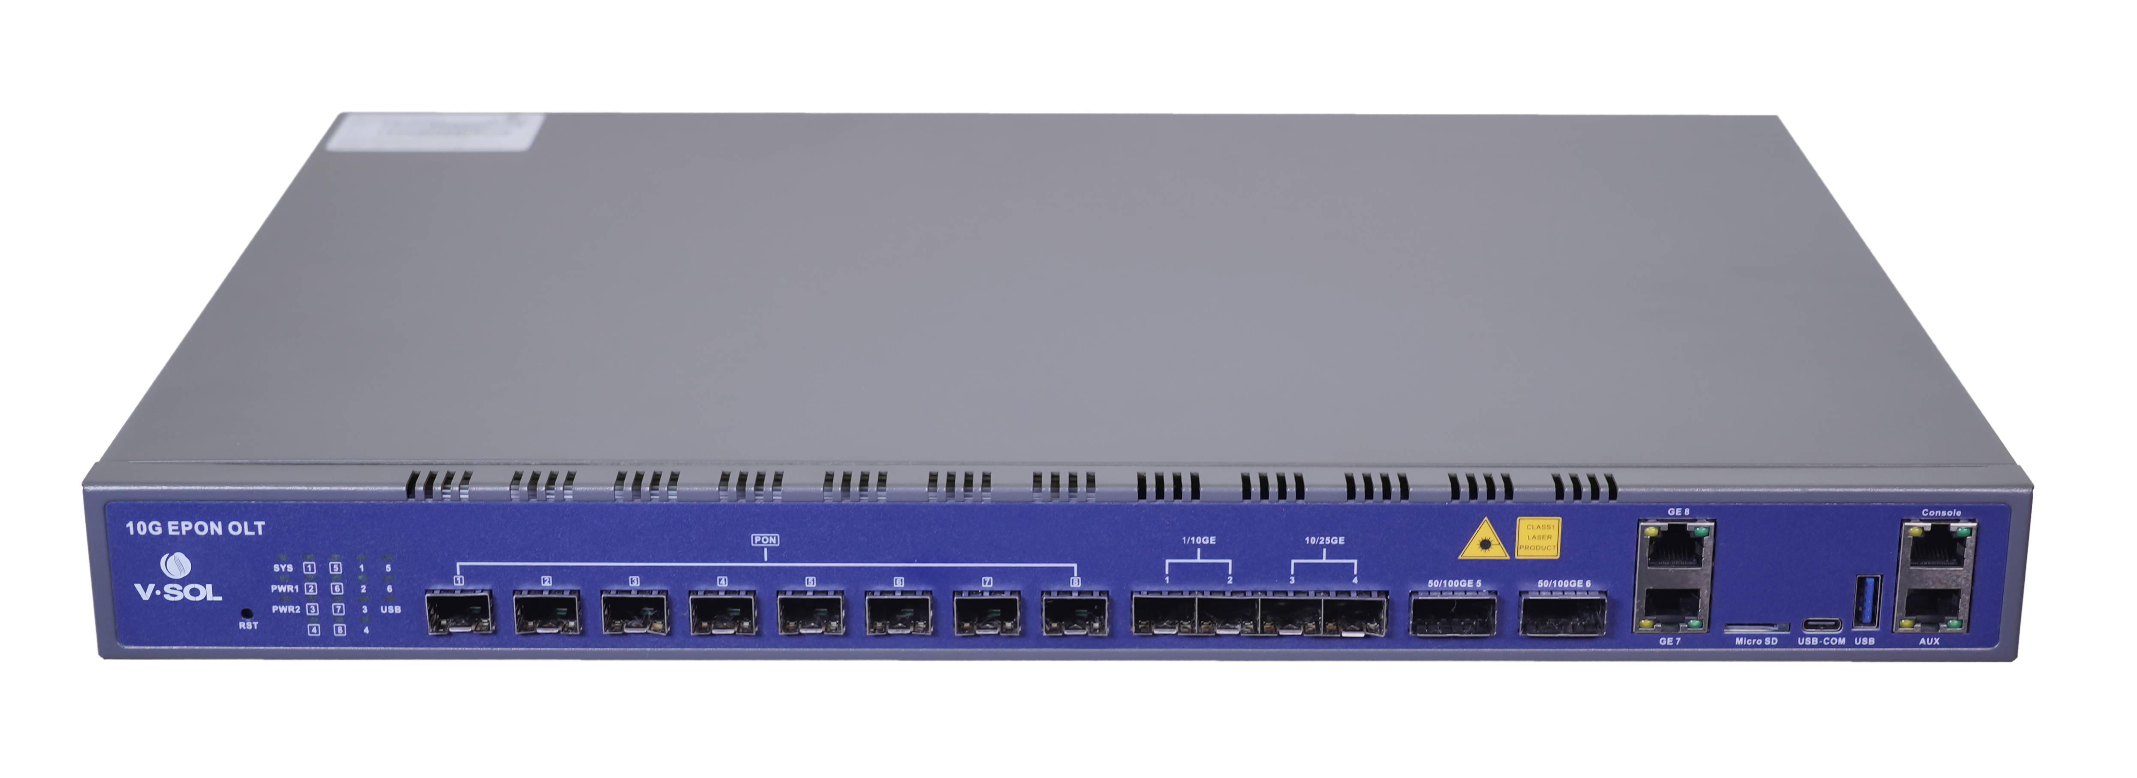
V3600D8
8-Port 10G EPON OLT
Highlights
High Performance Chipset
100Gbps QSFP28 High-Speed Uplink
Compliant With IEEE 802.3ah and 802.3av
Introduction:
V-SOL V3600D8 is a 8-Port 10G EPON OLT which is standardized in IEEE 802.3av and is evolved from the EPON standard IEEE 802.3ah. V3600D8 has good compatibility so that 10G EPON ONUs can coexist with EPON ONUs in an ODN.t is appropriate to be deployed in compact room environment. The OLT's can be used for FTTx networks, 5G wireless networks and other network environments.
V3600D8 provides 2*GE(RJ45), 2*10GE(SFP+), 2*25GE(SFP28) and 2*100GE(QSFP28) slots independent interface for uplink, and 8*10G EPON ports for downlink(Maximum Split Ratio is 1:256).
Interface of V3600D8
2×40/50/100GE
(QSFP28)
10G EPON (SFP+)
2×1/10GE
(SFP+)
2×10/25GE
SFP28
MicroSD
USB
Console & Mgmt Port
2×1GE
(RJ45)
Type-C
Ordering Information:
Product Name | Product Description | Power Configuration | Accessories
V3600D8 | 8*10G EPON,2*GE(RJ45)+ 2*10GE(SFP+)+2*25GE(SFP28)+2*100GE(QSFP28) | 1*AC power; 2*AC power; 1*DC power; 2* DC power; 1*AC power + 1* DC power. | 10G EPON SFP+ PR30 module 10G EPON SFP+ PRX30 module 100GE QSFP28 module 25GE SFP28 module 10GE SFP+ module
VSOL product datasheet | Updated: 15-11-2021 | Rev.1.3 | www.vsolcn.com

Slide 2
V3600D8 8 Ports 10G EPON OLT
Technical Specifications:
Management Ports
1*10/100BASE-T out-band port, 1*CONSOLE port，1 Type-C
Multicast
IGMP snooping
8K IP Multicast Groups
EPON Function
Support port-based rate limitation and bandwidth control
In compliant with IEEE802.3ah, IEEE802.3av standard
Support data encryption, multi-cast, port VLAN, separation, RSTP, etc
Support Dynamic Bandwidth Allocation (DBA)
Support ONU auto-discovery/link detection/remote upgrade of software
Support VLAN division and user separation to avoid broadcast storm
Support various LLID configuration and single LLID configuration
Different user and different service could provide different QoS by means of different LLID channels
Support power-off alarm function, easy for link problem detection
Support broadcasting storm resistance function
Support port isolation between different ports
Support ACL to configure data packet filter flexibly
Specialized design for system breakdown prevention to maintain stable system
Support dynamic distance calculation on EMS online
PON Port Specification
DHCP
Transmission Distance: 20KM
10Gbps 1577nm TX
1.25Gbps 1490nm TX
1.25Gbps 1310nm RX
10Gbps 1270nm RX
Connector: SC/UPC
Fiber Type: 9/125μm SMF
DHCP server
DHCP relay
DHCP snooping
Layer 3 Features
ARP proxy
Static route
4K hardware Host Routes
16K hardware Subnet Routes
Support RIPv1/v2, OSPFv2
Support PPPoE+
Management Mode
SNMP/Telnet/CLI/WEB/SSH v2/EMS
Management Function
Fan Group Control;
Port Status monitoring and configuration management;
Online ONU configuration and management;
User management, Alarm management
Security Management
Support IEEE802.1x, Radius, Tacacs+
Support DHCP Snooping,DHCP Opiton82, IP Source Guard
Support HTTPs, SSHv2
Layer 2 Feature
IPv6 Feature
16K MAC address
Support port VLAN and protocol VLAN
Support 4096 VLANs
Support VLAN tag/Un-tag, VLAN transparent transmission, QinQ
Support IEEE802.3d trunk
Support RSTP, MSTP
QoS based on port, VID, TOS and MAC address
IEEE802.x flow control
Port stability statistic and monitoring
Support P2P Function
Support IPv6 Neighbor Discovery, SLAAC Snooping
Support DHCPv6 Server,DHPCv6 Relay,DHCPv6 Snooping
Support IPV6 Static Route
Support IPV6 Dynamic Route Protocol: RIPng,OSPFv3
Support MLD V1/V2
Support IPv6 ACL
Support IPv6 SNMP, Telnet, HTTPs, SSH management
Item |  | V3600D8
Backplane Bandwidth (Gbps) |  | 880
Port Forwarding Rate(Mpps) |  | 523.776
Chassis | Rack | 1U 19 inch standard box
Uplink Port | QTY | 6
 | 1/10GE(SFP +) | 2
 | 10/25GE(SFP28) | 2
 | 40/50/100GE(QSFP28) | 2
10G EPON Port | QTY | 8
 | Physical Interface | SFP+ Slots
 | Connector Type | PR30/PRX30
 | Max splitting ratio | 1:256
Electric port | QTY | 2
 | Physical Interface | RJ45
 | Rate | 1000M/100M/10M, adaptive
Dimension (LxWxH) |  | 442mm*369mm*46.6mm
Net Weight |  | 3.9kg
Power Supply |  | AC 100~240 V, 50/60 Hz, 200W
DC Power Supply |  | DC：-48V
Power Consumption |  | ≤145W
Operating Environment | Working Temperature | 0~+50°C
 | Storage Temperature | -40~+85°C
 | Relative Humidity | 5~90% (non-condensing)

