Slide 1
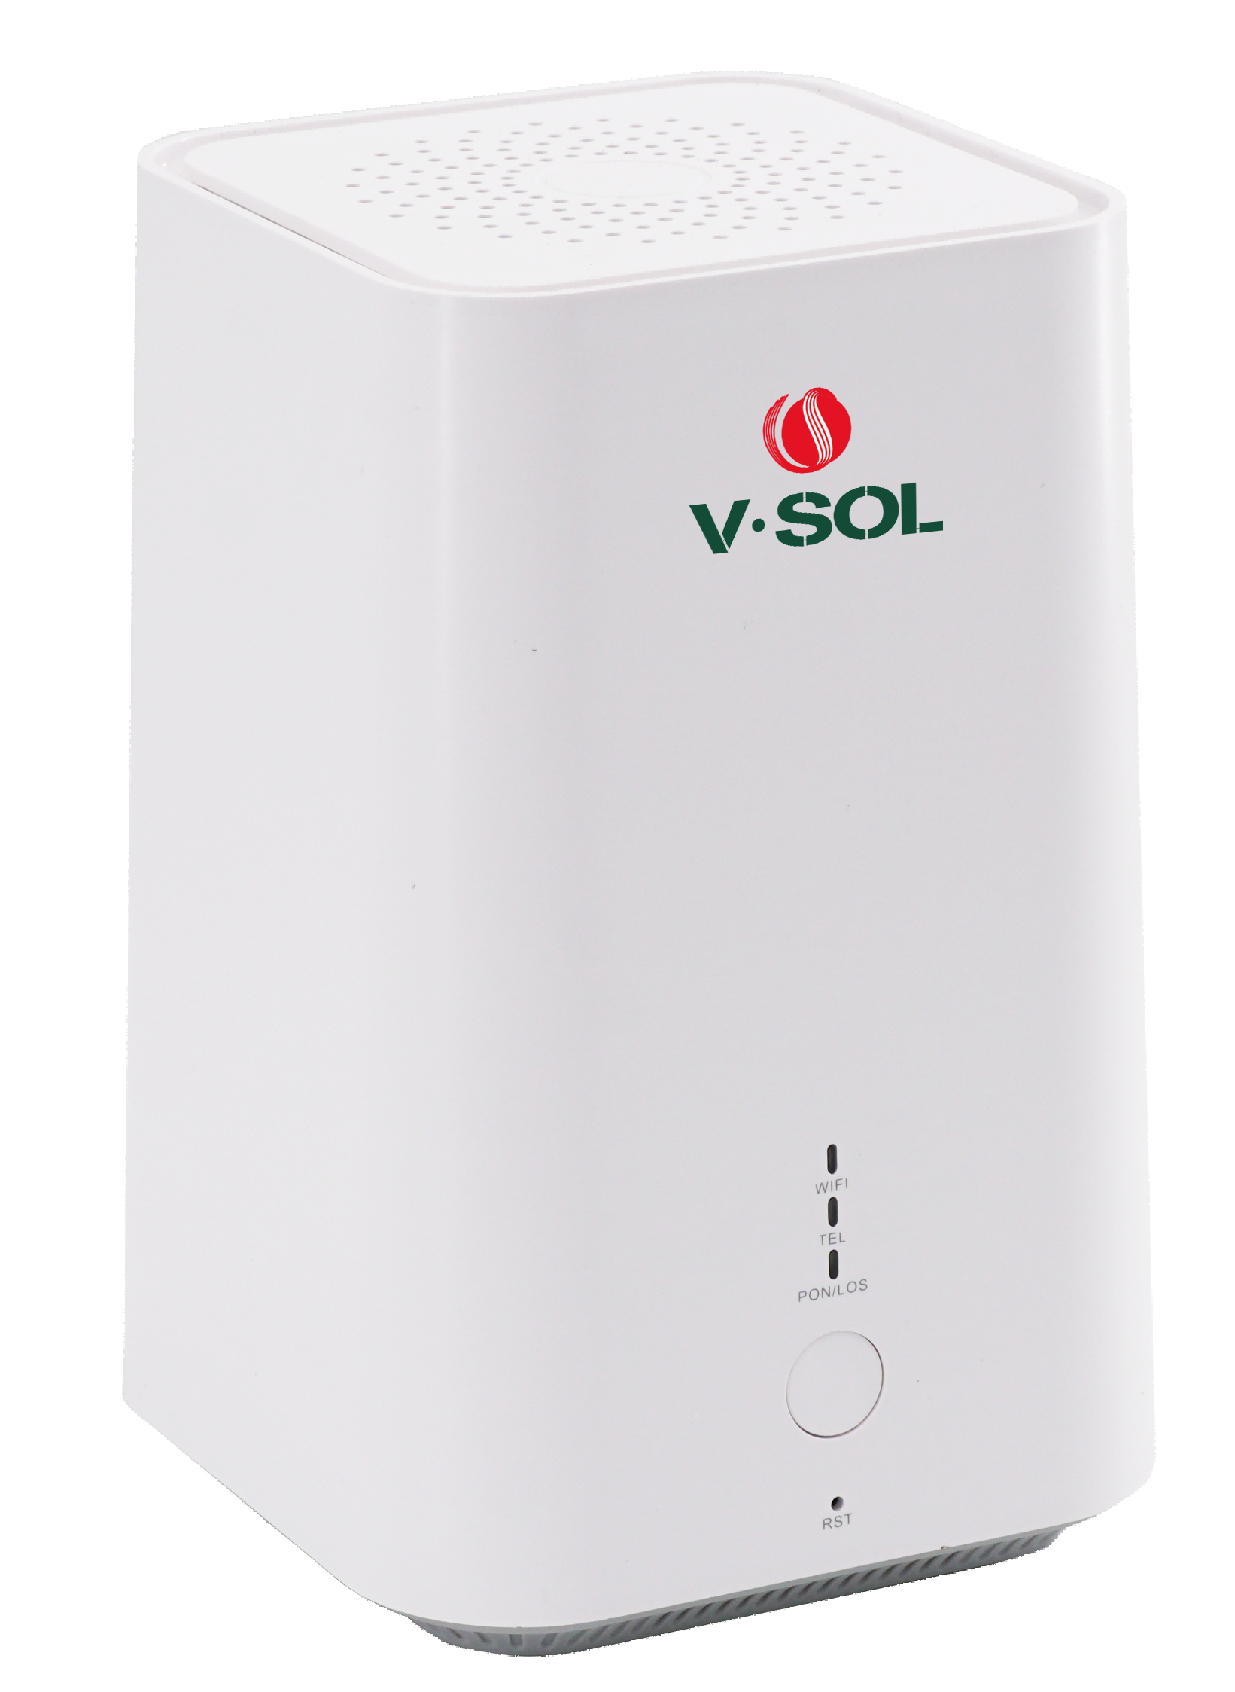
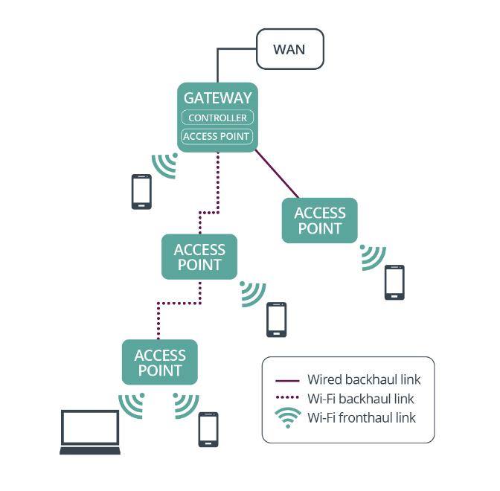
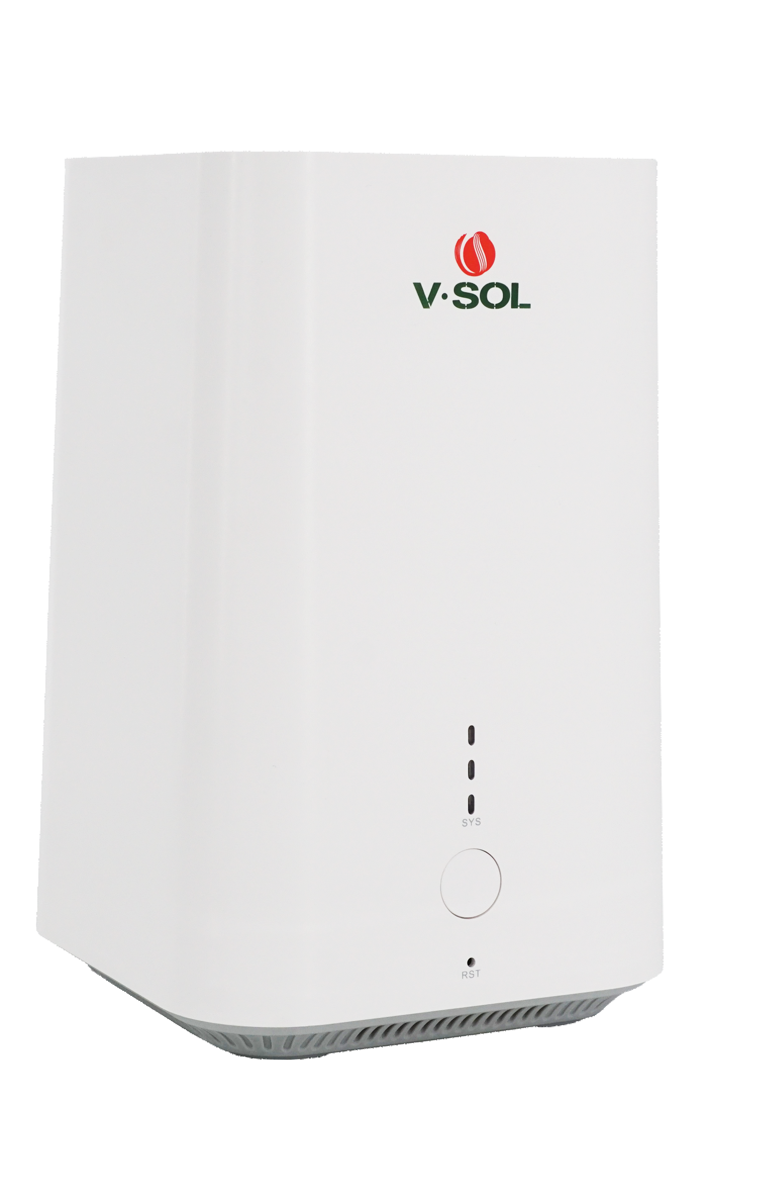
HG3610ACM
For more information, please scan this code:
1GE+1FE+WiFi5 WIFI Router
Key Features:
EasyMesh protocol-Support wired and wireless Mesh connections
WiFi5 Dual Band 1200Mbps
IPv4/IPv6 Stack
Introduction:
1GE+1FE+WIFI5 HG3610ACM Wireless Router is high performance wireless connectivity for Small Office and Home(SOHO) deploymensts and support dual band concurrent operation at 2.4GHz and 5GHz with combined throughput of 1.2Gbps(300Mbps at 2.4GHz and 867Mbps at 5GHz). HG3610ACM support Wi-Fi EasyMesh that brings a standards-based approach to Wi-Fi networks that utilize multiple access points (APs), combining the benefits of easy to use, self-adapting Wi-Fi with greater flexibility in device choice that comes with interoperable Wi-Fi EasyMesh devices.
Application Chart:
EasyMesh for Full-coverage
HG323AC-B
or HG3610ACM
HG3610ACM
HG3610ACM
HG3610ACM
VSOL product datasheet | Updated: 24 -11 - 2021 | Rev.2.0 | www.vsolcn.com

Slide 2
Hardware Parameter
Function Data
Dimension | 117mm×117mm×240mm(L×W×H)
Net weight | 560g
Operating condition | Operating temp: 0 ~ +55°C Operating humidity: 10 ~ 90% (non-condensing)
Storing condition | Storing temp: -30 ~ +60°C Storing humidity: 10 ~ 90% (non-condensing)
Power adapter | DC 12V,1A, external AC-DC power adaptor
Power supply | ≤10W
Interface | 1GE+1FE+WiFi5
Indicators | 3, For Status of SYS,LAN1,LAN2
Management Mode | Web
Data Service | Full speed non-blocking switching 2K MAC address table Integrated port monitoring, port mirroring, port rate limiting, port SLA, etc Support auto polarity detection of Ethernet ports (AUTO MDIX) Integrated IEEE802.1p QoS with four level priority queues Support IGMP v1/v2/v3 snooping/proxy and MLD v1/v2 snooping/proxy Support bridge, router and bridge/router mixed mode
Wireless | Support Wireless AP mode Support 802.11 b/g/n/ac Support Multiple SSID Authentication : WEP/WAP-PSK(TKIP)/WAP2-PSK(AES) Modulation type: DSSS, CCK and OFDM Encoding scheme: BPSK, QPSK, 16QAM and 64QAM Support EasyMesh protocol
WAN/LAN | PPPoE,DHCP Client,Static IP
Interface Parameter
LAN interface | 1*10/100Mbps and 1*10/100/1000Mbps auto adaptive WAN/LAN Ethernet interface , RJ45 connectors
WLAN interface | Compliant with IEEE802.11b/g/n/ac 2.4GHz Operating frequency: 2.400-2.483GHz 5.0GHz Operating frequency: 5.150-5.825GHz WiFi: MIMO 2×2 For 2.4GHz,MIMO 2×2 For 5.0GHz, 4×5dBi external antenna, rate up to 1.166Gbps, Multiple SSID TX power: 11n--22dBm/11ac--24dBm
WPS Button | Quickly pair two EasyMesh WIFI routers with the WPS button.
Product Name | Product Description | Accessories
HG3610ACM | 1GE+1FE+WiFi5 | AC-DC power adaptor: DC12V/1.0A
Official Website: https://www.vsolcn.com/ E-mail: sales@ftthcpe.com support@ftthcpe.com

