Slide 1
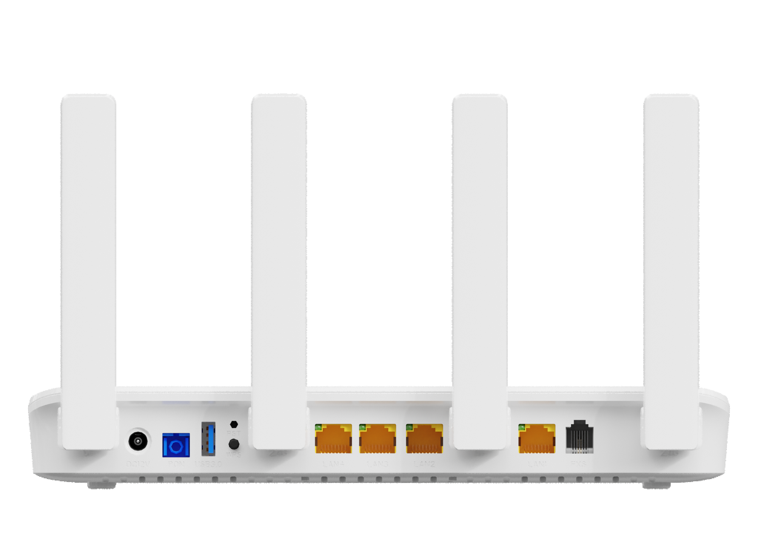
HG325AX
1XPON+4GE+1POTS+1USB3.0+WiFi6 HGU ONT
Key Features:
Realtek
PON+WIFI6
Gig+ performance
Next-Gen Gigabit WiFi6
2.4GHz & 5GHz Dual Band
Speed up to 1.8 Gbps
IPv4/IPv6 Dual Stack
USB3.0 Interface
For Shared Storage/Printer
Introduction:
HG325AX (4GE+1POTS+WiFi6 XPON HGU ONT) is a broadband access device specially designed to meet the needs of fixed network operators for FTTH and triple play services.
The ONT is based on high-performance chip solutions, supports XPON dual-mode technology (EPON and GPON), and also supports IEEE802.11b/g/n/ac/ax WiFi 6 technology and other Layer 2/Layer 3 functions, providing data service for carrier-grade FTTH applications. In addition, the ONT also supports the OAM/OMCI protocol, and we can configure or manage various services of the ONT on the VSOL OLT.
The ONT has high reliability, is easy to manage and maintain, and has QoS guarantees for various services. It conforms to a series of international technical standards such as IEEE802.3ah and ITU-T G.984
Application Chart:
VoIP
Internet
HG325AX
OLT
SC/UPC
WiFi Device
NAS
IPTV
PC
IPC
IP Phone

Slide 2
Hardware Parameter
Function Data
Dimension | 250mm×145mm×36mm(L×W×H)
Net weight | 0.34Kg
Operating condition | Operating temp:0 ~ +55°C Operating humidity:5 ~ 90% (non-condensed)
Storing condition | Storing temp: -30 ~ +60°C Storing humidity: 5 ~ 90% (non-condensed)
Power adapter | DC 12V, 1.5A, external AC-DC power adaptor
Power supply | ≤18W
Interface | 1XPON+4GE+1POTS+USB3.0+WiFi6
Indicators | PWR,PON ,LOS,WAN,WiFi,FXS, ETH1~4,WPS,USB
O&M | WEB/TELNET/OAM/OMCI/TR069 Support private OAM/OMCI protocol and Unified network management of VSOL OLT
Internet connection | Support Routing Mode
Multicast | IGMP v1/v2/v3, IGMP snooping MLD v1/v2 snooping
VoIP | SIP and IMS SIP G.711a/G.711u/G.722/G.729 Codec Echo cancellation,VAD/CNG,DTMF Relay T.30/T.38 FAX Caller Identification/Call Waiting/Call Forwarding/Call Transfer/Call Hold/3-way Conference Line testing according to GR-909
WIFI | Wi-Fi 6: 802.11a/n/ac/ax 5GHz & 802.11g/b/n/ax 2.4GHz WiFi Encryption:WEP-64/WEP-128/ WPA/WPA2/WPA3 Support OFDMA, MU-MIMO, Dynamic QoS, 1024-QAM Smart Connect for one Wi-Fi name - One SSID for 2.4GHz and 5GHz dual band
L2 | 802.1D&802.1ad bridge, 802.1p Cos,802.1Q VLAN
L3 | IPv4/IPv6, DHCP Client/Server,PPPoE, NAT, DMZ, DDNS
Firewall | Anti-DDOS, Filtering Based on ACL/MAC /URL
Interface parameter
PON Interface | 1XPON port(EPON PX20+ and GPON Class B+) SC single mode, SC/UPC connector TX optical power: 0～+4dBm RX sensitivity: -27dBm Overload optical power: -3dBm(EPON) or -8dBm(GPON) Transmission distance: 20KM Wavelength: TX 1310nm, RX1490nm
User interface | 4×GE, Auto-negotiation,RJ45 ports 1×POTS RJ11 Connector
Antenna | 4 ×5dBi external antennas
USB | 1×USB 3.0 for Shared Storage/Printer
Product Name | Product Description | Accessories
HG325AX | 1XPON+4GE+1POTS+WiFi6 | AC-DC power adaptor: DC12V / 1.5A

