Slide 1
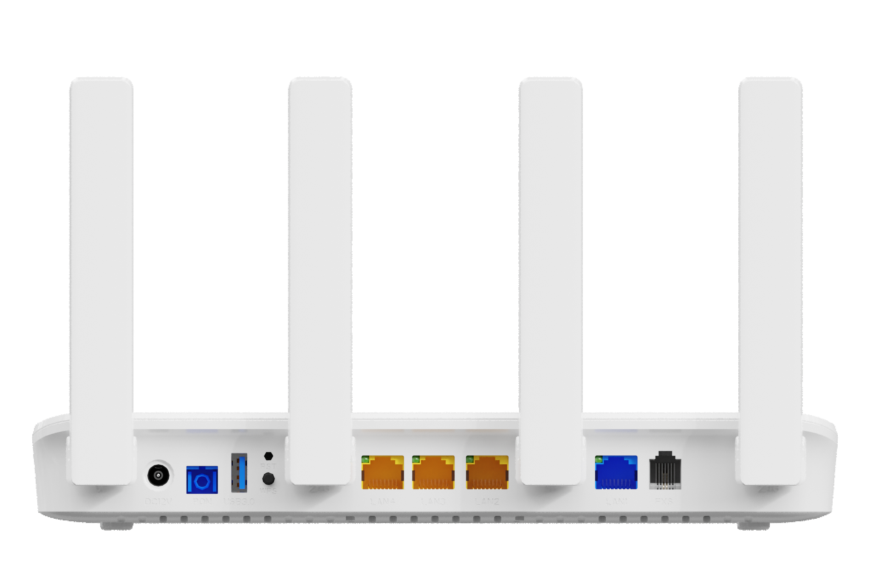
HG3110AX
XGS-PON+1*2.5GE+3*GE+1*POTS+1*USB3.0+WiFi 6 HGU ONT
(PON is 10G EPON or XG-PON or XGS-PON)
Key Features:
10G PON Solution
Realtek Chipset
Next-Gen Gigabit WiFi6
2.4GHz & 5GHz Dual Band
Speed up to 1.8 Gbps
IPv4/IPv6 Dual Stack
USB3.0 Interface
For Shared Storage/Printer
Introduction:
Leveraged the latest WiFi 6(AX1800) technology and equipped with IEEE 802.3av(10G-EPON)/ITU-T G.987(XG-PON)/ITU-T G.9807.1 (XGS-PON) PON interface and IEEE802.11ax(WiFi 6) interface, V-SOL XGS-PON HGU HG3110AX supports the full Triple Play of services enabling Data, Voice and Video services through Ethernet, Wi-Fi, FXS and USB standard interfaces, help Internet Service Providers to deliver internet service more than 2.5Gbps which is limited by GPON.
HG3110AX built-in Ethernet LAN ports, one 2.5GE BASE-T port and 3x1GE BASE-T ports support ultrafast device connection, and includes powerful and enhanced WLAN interface based on MU-MIMO OFDMA 2x2 2.4GHz MIMO and 5Ghz 2x2 MIMO Wi-Fi antennas supporting 802.11a/b/g/n/ac/ax standards over 2.4GHz and 5GHz wireless frequency bands for Internet application such as video, email, web surfing, files upload/download and online gaming，and it provides VoIP service through POTS port.
Application Chart:
VoIP
Internet
HG3110AX
OLT
SC/UPC
10G EPON OLT or
XGPON OLT or
XGSPON OLT
WiFi Device
IPC
IPTV
2.5GbE
Device
POTS
PC
VSOL product datasheet | Updated: 20 -12 - 2021 | Rev.1.3| www.vsolcn.com

Slide 2
Hardware Parameter
Function Data
Dimension | 244mm*131mm*36mm (L*W*H)
Net weight | NBD
Operating condition | Operating temp:0 ~ +55°C Operating humidity:5 ~ 90% (non-condensed)
Storing condition | Storing temp: -30 ~ +60°C Storing humidity: 5 ~ 90% (non-condensed)
Power adapter | 12V/2A
Power supply | 24W
Interface | 1*2.5GE+3*GE+1*POTS+1*USB3.0+WiFi 6
Indicators | PON/LOS, WAN, USB, PHONE, WIFI
O&M | WEB/TELNET/OAM/OMCI/TR069 Support private OAM/OMCI protocol and Unified network management of VSOL OLT
Internet connection | Support Bridge/Router mode
Multicast | IGMP v1/v2/v3, IGMP snooping MLD v1/v2 snooping
VoIP | SIP and IMS SIP G.711a/G.711u/G.722/G.729 Codec Echo cancellation,VAD/CNG,DTMF Relay T.30/T.38 FAX Caller Identification/Call Waiting/Call Forwarding/Call Transfer/Call Hold/3-way Conference Line testing according to GR-909
WIFI | Wi-Fi 6: 802.11a/n/ac/ax 5GHz & 802.11g/b/n/ax 2.4GHz WiFi Encryption:WEP-64/WEP-128/ WPA/WPA2/WPA3 Support OFDMA, MU-MIMO, Dynamic QoS, 1024-QAM Smart Connect for one Wi-Fi name - One SSID for 2.4GHz and 5GHz dual band
L2 | 802.1D&802.1ad bridge, 802.1p Cos,802.1Q VLAN
L3 | IPv4/IPv6, DHCP Client/Server,PPPoE, NAT, DMZ, DDNS
Firewall | Anti-DDOS, Filtering Based on ACL/MAC /URL
Interface parameter
PON Interface | 10G PON port: Class B+ SC single mode, SC/UPC connector TX optical power: 8dBm RX sensitivity: -29.5dBm Overload optical power: -7dBm Transmission distance: 20km Wavelength: 10G EPON: DS 1577nm/US 1310nm XG(S)-PON:DS 1577nm/US 1270nm
10G PON layer | IEEE 802.3av(10G-EPON) ITU-T G.987(XG-PON) ITU-T G.9807.1 (XGS-PON)
User interface | 1*2.5GE, Auto-negotiation,RJ45 ports 3*GE, Auto-negotiation,RJ45 ports 1*POTS, RJ11 Connector 1*USB3.0
Antenna | 4 ×5dBi external antennas
USB | 1×USB 3.0 for Shared Storage/Printer
Product Name | Product Description | Accessories
HG3110AX | 1*2.5GE+3*GE+1*POTS+USB3.0+WiFi 6 | AC-DC power adaptor: DC12V / 2A
Official Website: https://www.vsolcn.com/ E-mail: sales@ftthcpe.com support@ftthcpe.com

