Slide 1


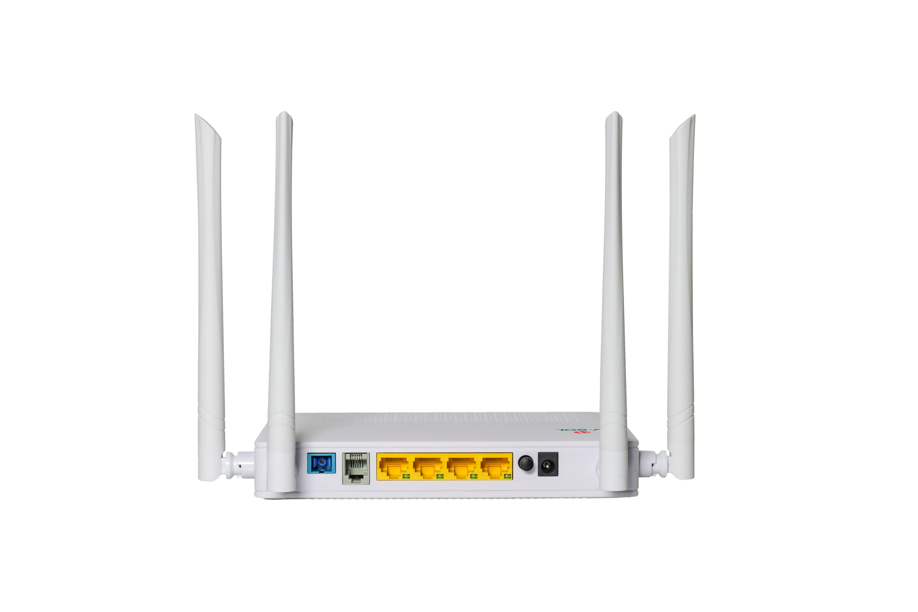








HG325DAC
With FEM
1*XPON+4GE+1POTS+WiFi 5 HGU ONT
Key Features:
XPON Dual Mode
Plug and play,auto-detecting, auto-configuration
802.11n/ac dual band WiFi, WIFI-FEM module
Support full management of HGU devices
Support guaranteed QoS
Support IPv4/IPv6
Introduction:
HG325DAC (4GE+1POTS+WiFi5 XPON HGU ONT) is a broadband access device specially designed to meet the needs of fixed network operators for FTTH and triple play services.
The ONT is based on high-performance chip solutions, supports XPON dual-mode technology (EPON and GPON), and also supports IEEE802.11b/g/n/ac WiFi 5 technology and other Layer 2/Layer 3 functions, providing data service for carrier-grade FTTH applications. This ONU has a FEM module, which can improve the transmission power and reception sensitivity of WIFI, making the coverage of WIFI larger. In addition, the ONT also supports the OAM/OMCI protocol, and we can configure or manage various services of the ONT on the VSOL OLT.
The ONT has high reliability, is easy to manage and maintain, and has QoS guarantees for various services. It conforms to a series of international technical standards such as IEEE802.3ah and ITU-T G.984.
Application Chart:
FEM Chip
Internet
WIFI AC
OLT
Smart phone
SC/UPC
Splitter
Topset
Phone
Computer
IPTV
12V DC
VSOL product datasheet | Updated: 24 -11 - 2021 | Rev.2.0 | www.vsolcn.com

Slide 2
Hardware Parameter
Function Data
Dimension | 178mm×120mm×30mm(L×W×H)
Net weight | 0.3KG
Operating condition | Operating temp: 0°C~+50°C Operating humidity:10%~90% (non-condensing)
Storing condition | Storing temp: -30℃~+70°C Storing humidity: 10%~90% (non-condensing)
Power adapter | DC 12V/1.5A
Power supply | 12W
Interface | 4GE+1POTS+WiFi 5
LED Indicators | PWR, LOS, PON, 2.4G, 5G, PHONE
O&M | OAM/OMCI,Telnet,WEB,TR069 Support full management of HGU functions by VSOL OLT
Connect Mode | Support bridge, router & bridge/router mixed mode
QoS | Support 4 queues Support SP, WRR, 802.1P and DSCP
Data Service Functions | • Full speed non-blocking switching • 2K MAC address table • 64 full range VLAN ID • Support VLAN tag, untag, transparent, trunk, translation mode • Integrated port monitoring, port mirroring, port rate limiting, port SLA, etc • Support auto polarity detection of Ethernet ports (AUTO MDIX) • Support IGMP v1/v2/v3 snooping/proxy and MLD v1/v2 snooping/proxy
Wireless | Integrated 802.11b/g/n/ac • Authentication:WEP/WAP-PSK(TKIP)/ WAP2-PSK(AES) • Modulation type:DSSS,CCK and OFDM • Encoding scheme:BPSK,QPSK,16QAM and 64QAM
VoIP | SIP and IMS SIP G.711a/G.711u/G.722/G.729 Codec Echo cancellation,VAD/CNG,DTMF Relay T.30/T.38 FAX Caller Identification/Call Waiting/Call Forwarding/Call Transfer/Call Hold/3-way Conference Line testing according to GR-909
L3 | IPv4, IPv6 and IPv4/IPv6 dual stack DHCP/PPPOE/Static Static route, DHCP Server NAT/DMZ/DDNS/Virtual Server
Security | Support Firewall Support Mac filter Based on MAC or URL Support ACL
Interface Parameter
PON interface | 1XPON port(EPON PX20+ & GPON Class B+) SC single mode, SC/UPC connector TX optical power: 0～+4dBm RX sensitivity: -27dBm Overload optical power: -3dBm(EPON) or -8dBm(GPON) Transmission distance: 20KM Wavelength: TX 1310nm, RX1490nm
WIFI interface | Compliant with IEEE802.11b/g/n/ac 2.4GHz: 2.4000-2.4835GHz; 5.0GHz: 5.150-5.825GHz WiFi:2.4GHz 2×2, 5.8GHz 2×2, 5dBi antenna, rate up to 1.167Gbps,Multiple SSID TX power: 2.4GHz: 23dBm; 5GHz: 27dBm RX power: 2.4GHz: HT40-MCS7 -72dBm, 5GHz: VHT80 MCS9 <-63dBm
LAN interface | 4*GE, Auto-negotiation RJ45 connectors
Pots interface | 1*FXS, RJ11 connector
Ordering Information:
Product Name | Product Description | Accessories
HG325DAC | 4GE+1POTS+WiFi5 | AC-DC power adaptor: DC12V / 1.5A
Official Website: https://www.vsolcn.com/ E-mail: sales@ftthcpe.com support@ftthcpe.com

