Slide 1

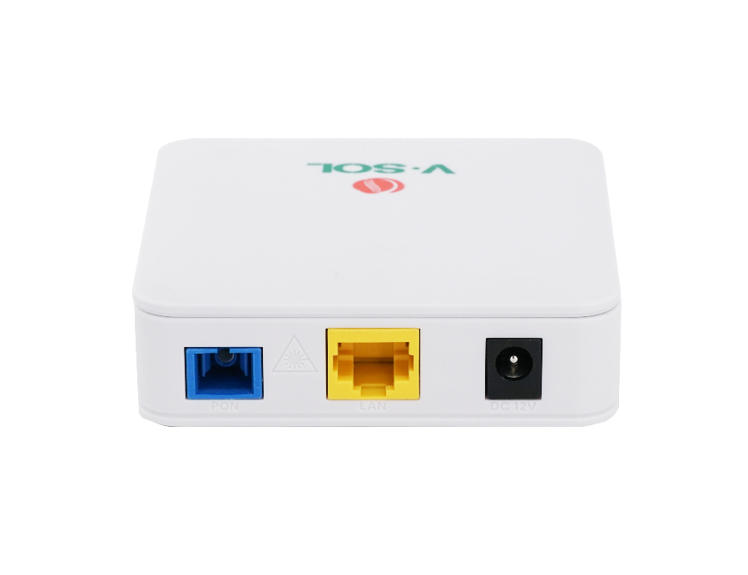










V2801SG / V2801RD
1*XPON+1GE ONU
Key Features:
XPON Dual Mode
Automatically Access to EPON/GPON
Detecting
Rogue ONU
Powerful Firewall
Wide Working Temp
-30℃～+60℃
Introduction:
V2801SG / V2801RD( XPON 1GE ONU ) is specially designed to meet the needs of telecom operators for FTTO (office), FTTD (desktop), FTTH (home), SOHO broadband access, video surveillance, etc. The ONU is based on high-performance chip technology solutions, and supports Layer 2/Layer 3 functions, providing data services for carrier-grade FTTH applications.
The ONT has high reliability and can be applied to a wide temperature environment; and has a powerful firewall function, which is easy to manage and maintain. It can provide QoS guarantee for different services. The ONT complies with international technical standards such as IEEE802.3ah and ITU-T G.984.
Application Chart:
Internet
WiFi Device
V2801SG/V2801RD
OLT
IPTV
Splitter
WiFi Router
PC
VSOL product datasheet | Updated: 24 -11 - 2021 | Rev.2.0 | www.vsolcn.com

Slide 2
Hardware Parameter
Product Feature
Dimension | 82mm×82mm×25mm(L×W×H)
Net weight | 0.085Kg
Operating condition | Operating temp: -30 ~ +60°C Operating humidity: 10 ~ 90% (non-condensing)
Storing condition | Storing temp: -30 ~ +70°C Storing humidity: 10 ~ 90% (non-condensing)
Power adapter | DC 12V, 0.5A, external AC-DC power adaptor
Power supply | ≤4W
Interfaces | 1GE
Indicators | SYS, LINK/ACT, REG
Basic | Support MPCP discover&register Support authentication Mac/Loid/Mac+Loid Support Triple Churning Support DBA bandwidth Support auto-detecting, auto-configuration, and auto firmware upgrade Support SN/Psw/Loid/Loid+Psw authentication
Alarm | Support Dying Gasp Support Port Loop Detect Support Eth Port Los
LAN | Support Port rate limiting Support Loop detection Support Flow control Support Storm control
VLAN | Support VLAN tag mode Support VLAN transparent mode Support VLAN trunk mode(max 8 vlans) Support VLAN 1:1 translation mode(≤8 vlans)
Multicast | Support IGMPv1/v2/Snooping Max Multicast vlan 8 Max Multicast Group 64
QOS | Support 4 queues Support SP and WRR Support 802.1P
L3 | Support IPv4/IPv6 Support DHCP/PPPOE/Static IP Support Static route Support NAT
Management | Support CTC OAM 2.0 and 2.1 Support ITUT984.x OMCI Support WEB Support TELNET Support CLI
Interface Parameter
PON interface | 1 XPON port(EPON PX20+ & GPON Class B+) SC single mode, SC/UPC connector TX optical power: 0～+4dBm RX sensitivity: -27dBm Overload optical power: -3dBm(EPON) or -8dBm(GPON) Transmission distance: 20KM Wavelength: TX 1310nm, RX1490nm
LAN interface | 1*GE, Auto-negotiation RJ45 connectors
Function Data
XPON Mode | Dual mode,Auto-access to EPON/GPON OLT
Uplink Mode | Bridging and Routing Mode
Abnormal protection | Detecting Rogue ONU, Hardware Dying Gasp
Firewall | DDOS, Filtering Based on ACL/MAC/URL
Product Name | Product Description | Accessories
V2801SG/V2801RD | 1GE | AC-DC power adaptor: DC12V/0.5A
Official Website: https://www.vsolcn.com/ E-mail: sales@ftthcpe.com support@ftthcpe.com

