Slide 1
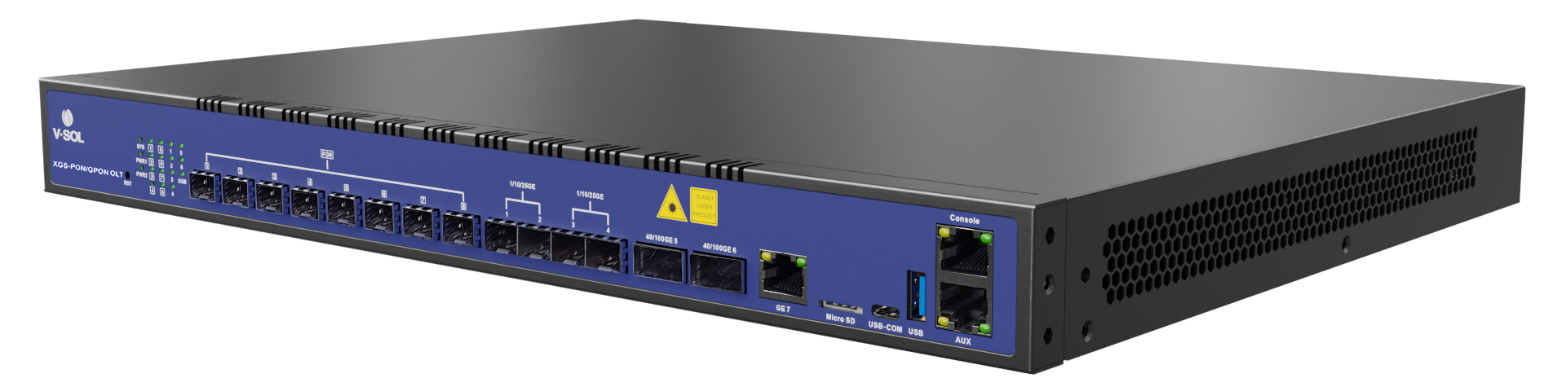



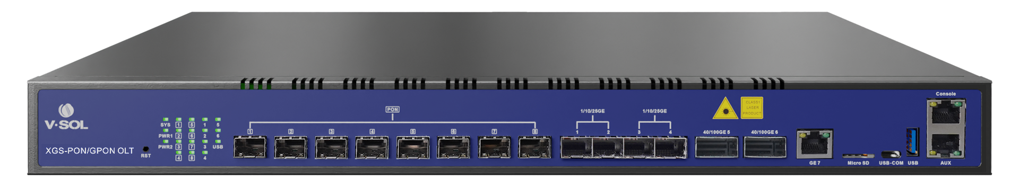
V3600G1-C
8-Port 10G Combo PON OLT
Highlights
High Performance Chipset
100Gbps QSFP28 High-Speed Uplink
Supports XGS-PON/XG-PON/GPON triple mode
Introduction:
VSOL V3600G1-C is an innovative 10G GPON OLT product with 8 PON ports and XG (S) - PON&GPON Combo compatibility. V3600G1-C supports smooth upgrades from GPON to XG (S) - PON, achieving high bandwidth and high-speed data transmission to meet large-scale deployment requirements. This product has comprehensive management and monitoring functions, simplifies operation and maintenance processes, and provides rich business features and scalability. V3600G1-C can build a 10G GPON network, providing excellent user experience and high-quality services to operators.
Interface of V3600G1-C:
MicroSD
USB-COM
XG(S)-PON/GPON
4×10/25GE
(SFP28)
2×40/50/100GE
(QSFP28)
USB
Ordering Information:
1GE
(RJ45)
Console & Mgmt ports
Product Name | Product Description | Power Configuration | Accessories
V3600G1-C | 8*XG(S)-PON/GPON, 1*GE(RJ45)+ 4*25GE(SFP28)+2*100GE(QSFP28) | 1*AC power; 2*AC power; | N2_C+ module 100GE QSFP28 module 25GE SFP28 module

Slide 2
Technical Specifications
Item |  | V3600G1-C
Chassis | Rack | 1U 19Inch Standard Box
Uplink Port | QTY | 8
 | RJ45(GE) | 1
 | SFP28(25GE) | 4
 | QSFP28(25GE/50GE/100GE) | 2
XG(S)-PON/GPON Port | QTY | 8
 | Physical Interface | SFP+ Slots
 | Connector Type | N2_C+
 | Optical Splitting Ratio | 1:256(Maximum), 1:128(Recommended)
Management Ports |  | 1*10/100/1000BASE-T out-band port, 1*CONSOLE port, 1*USB3.0, 1*Type-C USB console, 1*MicroSD port
Backplane Bandwidth (Gbps) |  | 970
Port Forwarding Rate(Mpps) |  | 598.176
XG(S)-PON/GPON Port Specification (N2_C+ module) | Transmission Distance | 20KM
 | XG(S)-PON Port Speed | GPON:Upstream1.244Gbps,Downstream 2.488Gbps XG-PON: Upstream 2.488Gbps, Downstream 9.953Gbps XGS-PON: Upstream 9.953Gbps, Downstream 9.953Gbps
 | Wavelength | GPON:Upstream：1310nm Downstream：1490nm XG(S)-PON:Upstream: 1270nm Downstream: 1577nm
 | Connector | SC/UPC
 | TX Power | GPON:+3dBm ~ +7dBm XG(S)PON:+4dBm ~ +7dBm
 | Rx Sensitivity | XGS-PON：-28dBm XG-PON: -29.5dBm GPON: -32dBm
 | Saturation Optical Power | XGS-PON：-7dBm XG-PON: -9dBm GPON: -12dBm
Lightning Protection | Power Lightning Protection | 6KV
 | Interface Lightning Protection | 4KV
Power Supply | AC | 90-264 VAC, 47/63Hz
Number of Fans |  | 4
Management Mode |  | CLI(Console/Telnet/SSH)/WEB
Management Function
SNMP,Telnet,CLI,WEB,SSH v2;
Fan Group Control
Port Status monitoring and configuration management
Online ONTconfiguration and management
User management
Alarm management
Layer2 Switch
32K Mac address
Support 4096 VLANs
Support port VLAN
Support VLAN tag/Un-tag, VLAN transparent transmission
Support VLAN translation and QinQ
Support storm control based on port
Support port isolation
Support port rate limitation
Support 802.1D and 802.1W
Support static LACP,Dynamic LACP
QoS based on port, VID, TOS and MAC address
Access control list
IEEE802.x flowcontrol
Port stability statistic and monitoring
DHCP
DHCP server,DHCP relay,DHCP snooping
DHCP option82
Layer 3 Route
ARP proxy
4096 hardware Host Routes,512 hardware Subnet Routes
Support Radius,Tacacs+
Support IP source guard
Support static route ,dynamic route RIP v1/v2,RIPng and OSPF v2/v3;
IPv6
Support NDP;
Support IPv6 Ping,IPv6 Telnet,IPv6 routing;
Support ACL based on source IPv6 address, destination IPv6 address, L4 port, protocol type, etc;
Support MLD v1/v2 snooping
Support VLAN division and user separation to avoid broadcast storm
Support power-off alarm function, easy for link problem detection
Support broadcasting storm resistance function
Support port isolation between different ports
Support ACL and SNMP to configure data packet filter flexibly
Specialized design for system breakdown prevention to maintain stable system
Support RSTP,IGMP Proxy
Dimension (L*W*H)
442mm*330mm*43.6mm
Weight
Net weight : NA KG
Power Consumption
150W
Working Environment
Working Temputure: -20°C ~+60°C
Working Humidity: 5%~95%(non-condensing)
Storage Environment
Storage Temputure: -40 ~ +70°C
Storage Humidity: 5%~95%(non-condensing)
PON Function
T-CONT DBA
x-GEM traffic
In compliant with ITU-T G.9807(XGS-PON) and ITU-T G.987(XG-PON)
Up to 20KM transmission Distance
Support data encryption, multi-cast, port VLAN, separation, RSTP, etc
Support ONT auto-discovery/link detection/remote upgrade of software
Multicast
IGMP snooping
2048 IP Multicast Groups;
Official Website: https://www.vsolcn.com/ E-mail: sales@ftthcpe.com support@ftthcpe.com

