Slide 1
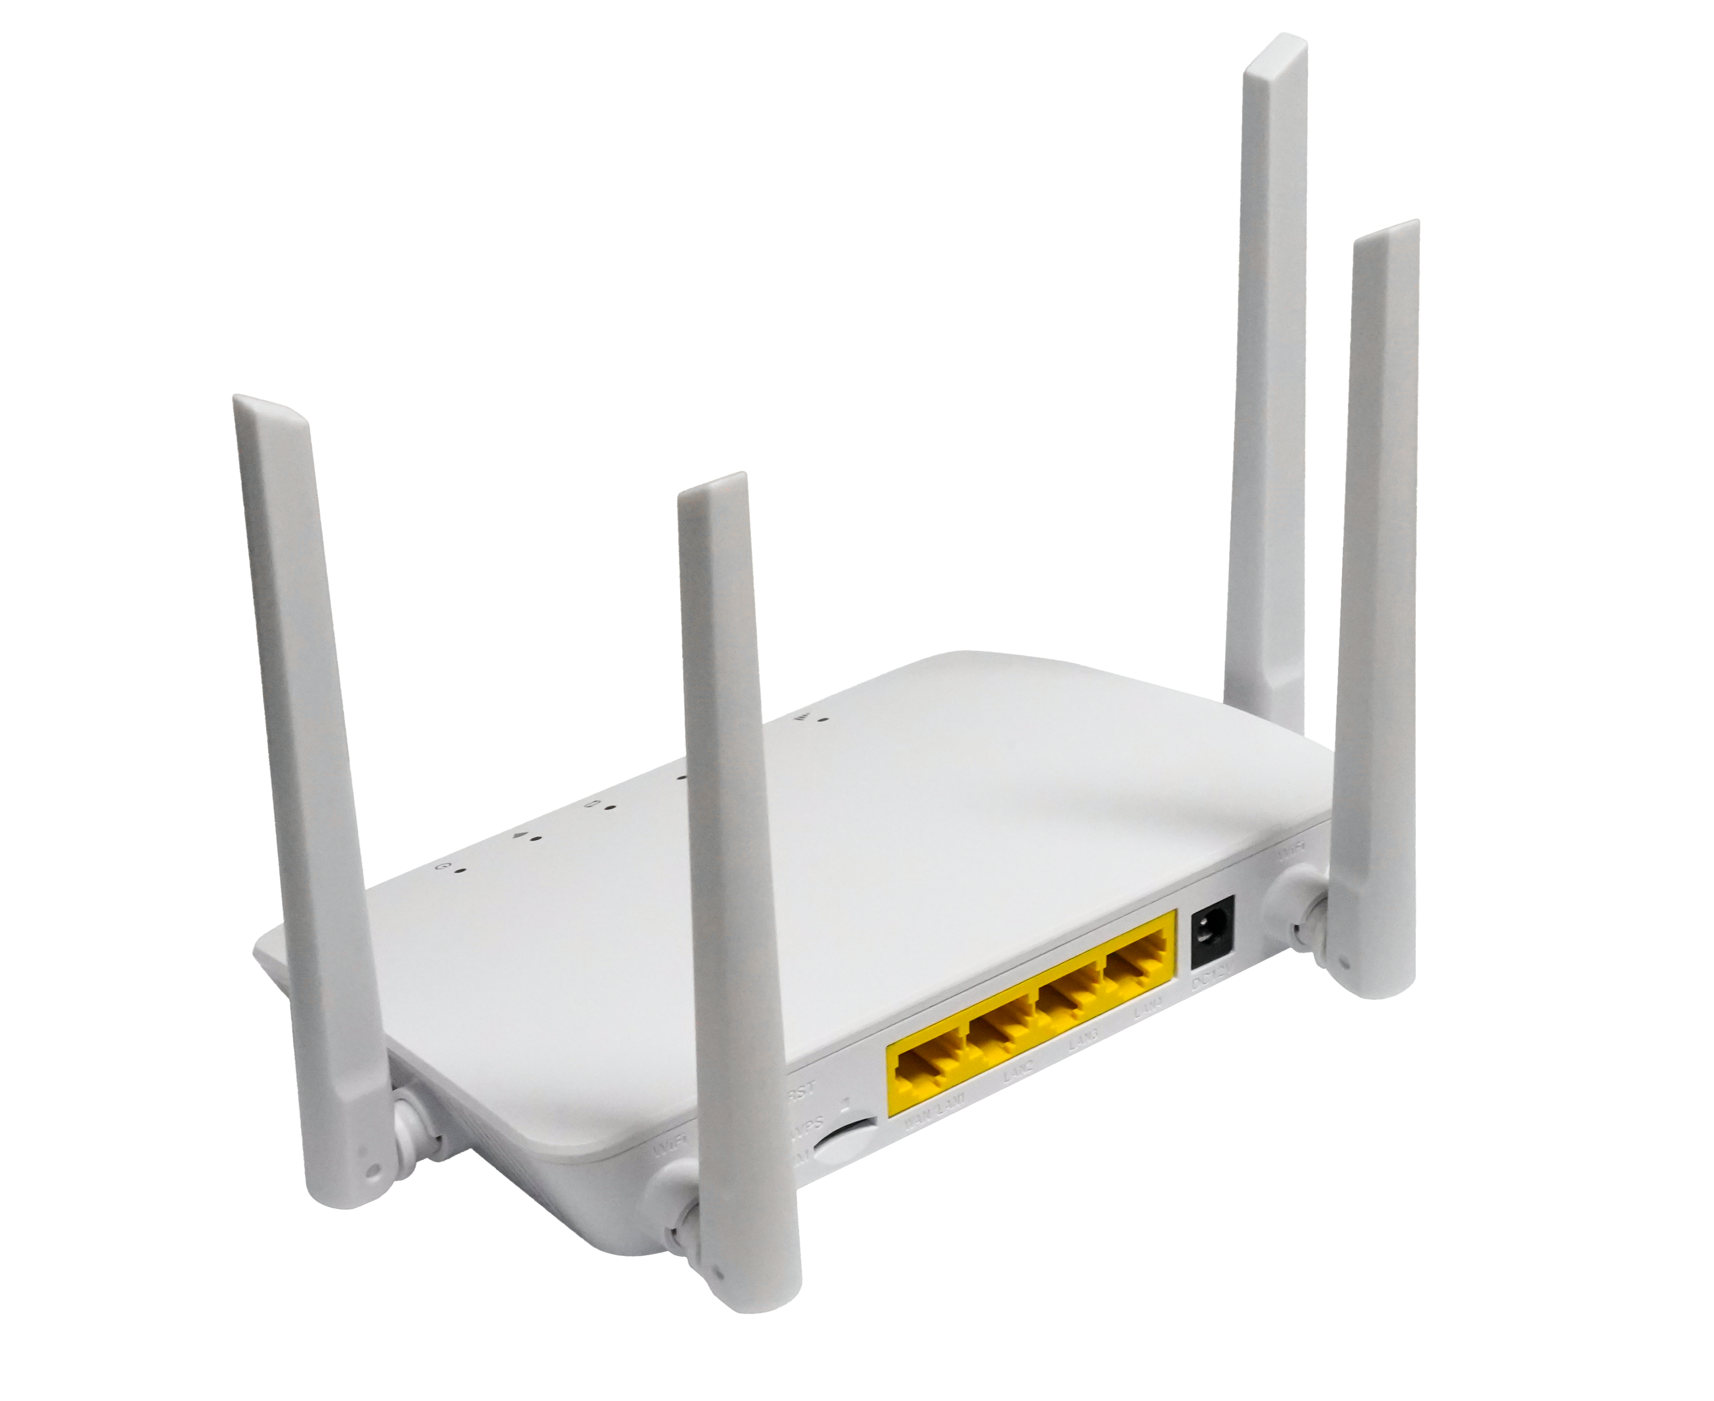
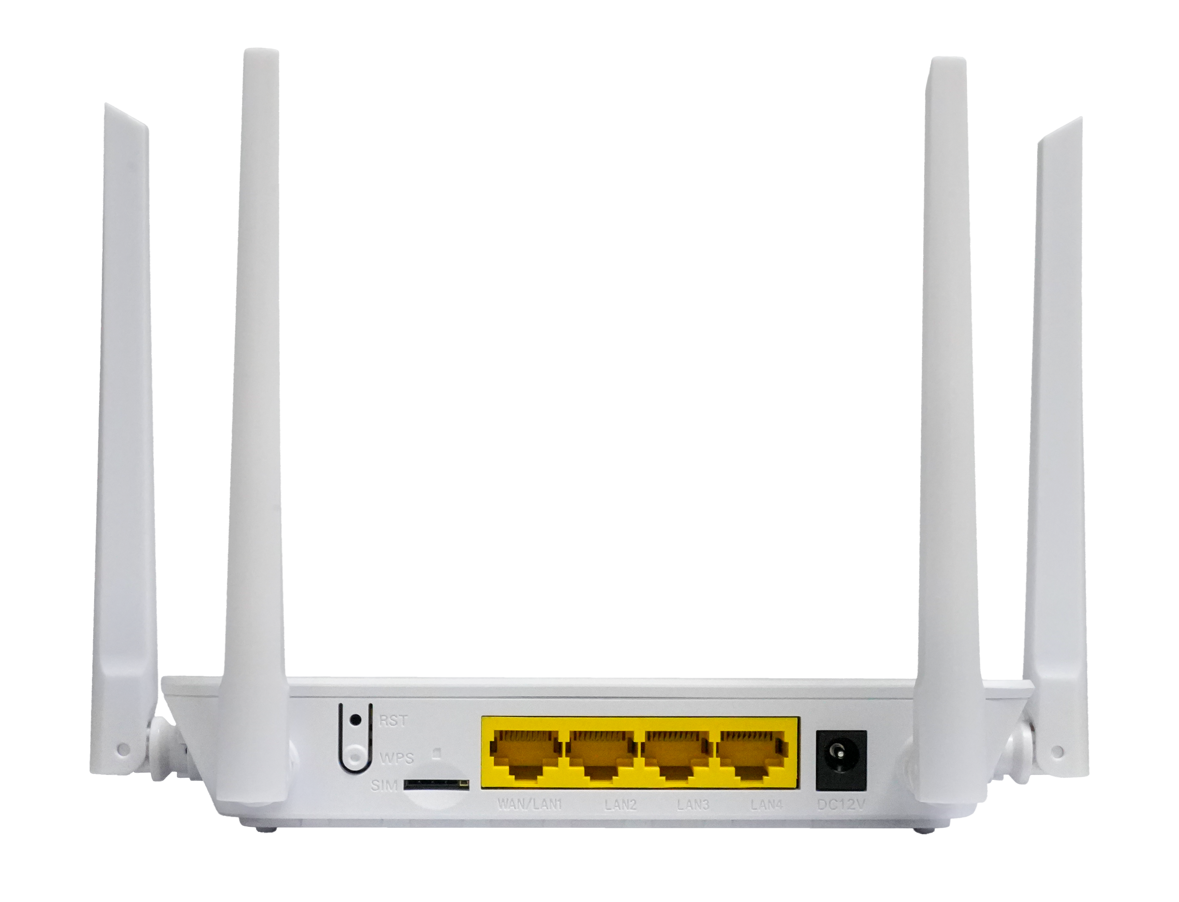
XMC1843E
LTE Cat4 CPE
Highlights:
LTE external antennas & WiFi external antennas
Support Firewall: PORT Filtering/ Port Mapping
Usage scenario: Indoor, Home, office, etc.
Introduction:
LTE CAT4 CPE XMC1843E is designed for carrier tenders.It provides four 100 Mbps Ethernet ports for simultaneous wired connection of 3~4 hosts, which fully meets the entertainment and audio needs of the whole family and the needs of a small office, watching videos and transferring data more smoothly. Experience affordable performance with XMC1843E.
Interface of XMC1843E:
USIM
Reset/WPS
WAN/LAN
3 x LAN
12V/1A

Slide 2
Hardware Parameter
WLAN Feature
Dimension | 150mm×105mm×30mm(L×W×H)
Net weight | About 233g
Operating condition | Operating temp: -20°C ~ +45°C
Storing condition | Storing temp: -20°C ~ +60°C
Power adapter | DC 12V/1A
Power supply | ≤12W
Interfaces | 4FE+USIM+WiFi
Indicators | POWER, WiFi, WAN/LAN, DATA , LTE
Buttons | Reset/WPS
Chipset | ASR5803W
Wi-Fi Frequency | 2.4GHz, 1~13Channel
Transmit Power | 17±2dBm @ 802.11b 15±2dBm @ 802.11g 14±2dBm @ 802.11n
Receiver input level sensitivity | <-76dBm at the antenna port, QPSK,11Mbps,1024 Byte PSDU @ 802.11b <-65dBm at the antenna port, 64QAM,54Mbps,1024 Byte PSDU @ 802.11g -64dBm at the antenna port, 64QAM, 65Mbps,4096 Byte PSDU@ 802.11n(HT20)
WiFi Antenna | External, 1 x 1 SISO
Protocol | 802.11b/g/n
Data Rate | 802.11b:Up to 11 Mbps 802.11g: Up to 54 Mbps 802.11n: Up to 72.2 Mbps
LTE WAN Feature
Chipset | ASR1803L (512Mbit+128Mbit)
Frequency Bands | XMC1843e-EU： LTE-FDD：B1/B3/B5/B7/B8/B20/B28 LTE-TDD：B38/B40/B41 WCDMA：B1/B5/B8 XMC1843e-AU： LTE-FDD：B1\B2\B3\B4\B5\B7\B8\B28\B66 LTE-TDD：B40 WCDMA：B1\B2\B4\B5\B8
Bandwidth | 1.4/3/5/10/15/20 MHz, comply with 3GPP
Modulation | DL: QPSK/16-QAM/64-QAM, comply with 3GPP UL: QPSK/16-QAM, comply with 3GPP
LTE Antenna | MIMO: 2 * 2 LTE Antennas
RF Power Level | LTE: Power Class 3 (23 dBm + 2.7/-3.7dB) UMTS: Power Class 3 (24 dBm +1.7/-3.7dB)
Data Rate | 4G: 3GPP R9 Cat4, FDD：DL/UL up to 150Mbps/50Mbps, TDD：DL/UL up to 110Mbps/10Mbps
 | 3G: 3GPP R7 DL/UL up to 21Mbps/5.76Mbps
Function Data
Interfaces | LAN: 4*RJ45 with 10/100Mbps, 1*RJ45 can support WAN/LAN Self-Adapter
USIM | Single, Standard SIM slot 4FF
System | Connection Status/Statistics/ Device Management
Language | Chinese/English/Español/Português, Customized
Mobile Service | Auto-APN according to USIM Auto Data Connection USSD Service PIN/PUK Management Network Mode Selection(3G/LTE/Auto)
Router | Support SSID, APN management,IPv4 DHCP Server, Dynamic IP, Static IP Access Control, Local Management Support OPEN, WPA2(AES)-PSK, WPA-PSK/WPA2-PSK Firewall PORT Filtering/ Port Mapping/ Port Forwarding
Management | TR069/FOTA
Operating System | Windows 7/8/XP/10 MAC OS 10.10+ Android 10/11 Linux Ubuntu 15.04+ Browser Edge, Firefox, Google Chrome, Safari, Opera

