Slide 1

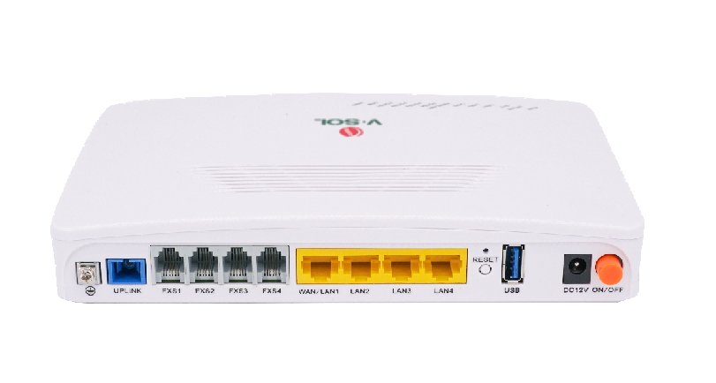



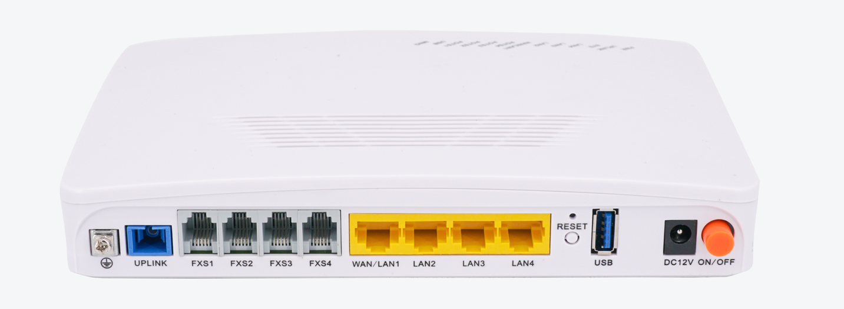




ICT3310D-4G4S
1*XPON+4GE+4POTS+USB 3.0 ONU
Key Features:
XPON Mode
Automatically Access to EPON/GPON
HD Voice
SIP Protocol
NAT, Firewall,
IPsec&L2TP VPN
O&M Mode:
EMS/Web/SNMP/CLI
Introduction:
ICT3310D series product is a broadband access device designed to meet the needs of users for multiple business integration.
ICT3310D-4G4S product is based on the PON technology mature and stable, high cost performance, combined with LAN switch technology and high quality VoIP technology, high reliability, easy management and good Quality of Service (QoS) guarantees, etc.
Application Chart:
Internet
OLT
Spliter
IP Phone
PC
USB3.0
12V DC
VSOL product datasheet | Updated: 24 -11 - 2021 | Rev.2.0 | www.vsolcn.com

Slide 2
Hardware Parameter
Function Data
Dimension | 205mm×140mm×37m(L×W×H)
Net weight | 0.5kg
Operating condition | Operating temp: -10 ~ +55°C Operating humidity: 10 ~ 90% (non-condensing)
Storing condition | Storing temp: -30 ~ +60°C Storing humidity: 10 ~ 95% (non-condensing)
Power adapter | DC 12V, 1.5A, external AC-DC, power adaptor
Power supply | ≤18W
Interfaces | 4GE+4POTS+USB 3.0
Indicators | PWR, SYS, UPLink, LOS, WAN/LAN1, FXS1~FXS4, LAN2~LAN4, LINK, USB
Multicast | Support IGMPv1/v2/v3/Proxy/Snooping and MLD Proxy/Snooping
QoS | Support 4 queues Support SP and WRR Support 802.1P Support DSCP
L3 | Support IPv4、IPv6 and IPv4/IPv6 dual stack Support DHCP/PPPOE/Statics Support Static route, NAT Support Bridge, Route ,Route and Bridge mixed mode Support DMZ, DNS, ALG, UPnP Support Virtual Server
DHCP | Support DHCP Server and DHCP Relay
VoIP | SIP and IMS SIP G.711a/G.711u/G.722/G.729 Codec Echo cancellation,VAD/CNG,DTMF T.30/T.38 FAX Caller Identification/Call Waiting/Call Forwarding/Call Transfer/Call Hold/3-way Conference Line testing according to GR-909
Security | Support Firewall based on Mac/ACL/URL
Management | Support OMCI(ITU-T G.984.x) & CTC OAM 2.0 and 2.1 Support WEB/TR069/TELNET/CLI
Application | Support L2TP & IPsec VPN Support EoIP Support VxLan Support Web Push
Interface Parameter
PON interface | 1XPON port(EPON PX20+ & GPON Class B+) SC single mode, SC/UPC connector TX optical power: 0～+4dBm RX sensitivity: -27dBm Overload optical power: -3dBm(EPON) or -8dBm(GPON) Transmission distance: 20KM Wavelength: TX 1310nm, RX1490nm
LAN interface | 4*GE, Auto-negotiation RJ45 connectors
POTS interface | 4*RJ11 connectors
USB interface | USB 3.0 For Shared Storage/Printer
Function Data
LAN | Support port rate limiting
WAN | Support set the LAN1 interface as WAN interface
VLAN | Support VLAN tag mode Support VLAN transparent mode Support VLAN trunk mode Support VLAN translation mode
Product Name | Product Description | Accessories
ICT3310D-4G4S | 4GE+4POTS+USB 3.0 | 12V/1.5A DC Adapter
Official Website: https://www.vsolcn.com/ E-mail: sales@ftthcpe.com support@ftthcpe.com

