Slide 1

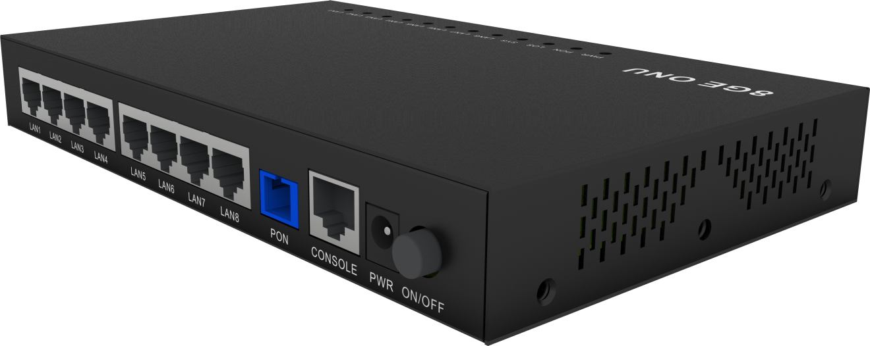








V2808-8GL
1*XPON+8GE MDU
Key Features:
XPON Dual Mode
Adaptive EPON/GPON
Detection of illegal ONU
Firewall Functions
Wide operating
temperature range
-10℃～+50℃
Introduction:
V2808-8GL ( XPON 8GE MDU ) is a broadband access device specially designed to meet the needs of telecom operators for FTTO (Office), FTTD (Desktop), FTTH (Home), SOHO access, and video surveillance access.This ONU is based on high-performance chip solutions, and also supports other Layer 2/Layer 3 functions, providing data service for carrier-grade FTTH applications.
This ONU has high reliability, can be used in environments with a wide range of temperatures, and has a powerful firewall function that is easy to manage and maintain. It can provide QoS guarantee for various data services. It conforms to a series of international technical standards such as IEEE802.3ah and ITU-T G.984.
Product Application:
Internet
V2808-8GL
OLT
IPTV
splitter
computer
VSOL product datasheet | Updated: 4 -8 - 2023 | Rev.1.0 | www.vsolcn.com

Slide 2
Hardware Parameter
Function Data
Dimension | 205*125*28mm(L×W×H)
Net weight | NA
Operating condition | Operating temp: -10 ~ +55°C Operating humidity: 10 ~ 90% (non-condensing)
Storing condition | Storing temp: -30 ~ +70°C Storing humidity: 10 ~ 90% (non-condensing)
Power adapter | DC 12V, 1A, external AC-DC power adaptor
Power supply | ≤12W
Interfaces | 8*GE,1*CONSOLE
Indicators | Power, PON, LOS, SYS,LAN1-8
Basic functions | MPCP discovery and registration Mac/oid/Mac+Loid authentication Triple Churning DBA bandwidth Automatic detection, configuration, and firmware upgrade SN/Psw/oid/oid+Psw authentication
Alarm | Dying Gasp port loop detection Eth Port Loss
LAN | Supports port rate restrictions Supports loop detection Supports flow control Supports storm control
VLAN | VLAN tag mode VLAN transparent mode VLAN trunk mode (up to 8 vlan) VLAN 1:1 translation mode (up to 8 VLAN)
Multicast | IGMPv1/v2/Snooping Up to 8 multicast vlan Up to 64 multicast groups
QOS | Supports 4 queues Supports SP and WRR Supports 802.1P
L3 | Supports IPv4/IPv6 Supports DHCP/PPPOE/Static IP Support static routing Support NAT
Management | CTC OAM 2.0 and 2.1 ITU-T 984. x OMCI Support for WEB Support for TELNET Support for CLI
Interface Parameter
PON interface | 1XPON port(EPON PX20+ and GPON Class B+) SC single mode, SC/UPC connector TX optical power: 0～+4dBm RX sensitivity: -27dBm Overload optical power: -3dBm(EPON) or -8dBm(GPON) Transmission distance: 20KM Wavelength: TX 1310nm, RX1490nm
LAN interface | 8*GE, Adaptive Ethernet interface, RJ45 connector
CONSOLE port | Used for managing ONU, serial port
Function Data
PON mode | XPON Dual Mode , Can access mainstream EPON/GPON OLTs
Uplink Mode | Bridging and Routing Mode
Abnormal protection | Supports detecting illegal ONU
Firewall Function | Support DDOS, Filtering Based on ACL/MAC/URL
Product Name | Product Description | Accessories
V2808-8GL | 8*GE | AC-DC power adaptor: DC12V/1A
Official Website: https://www.vsolcn.com/ E-mail: sales@ftthcpe.com support@ftthcpe.com

