Slide 1
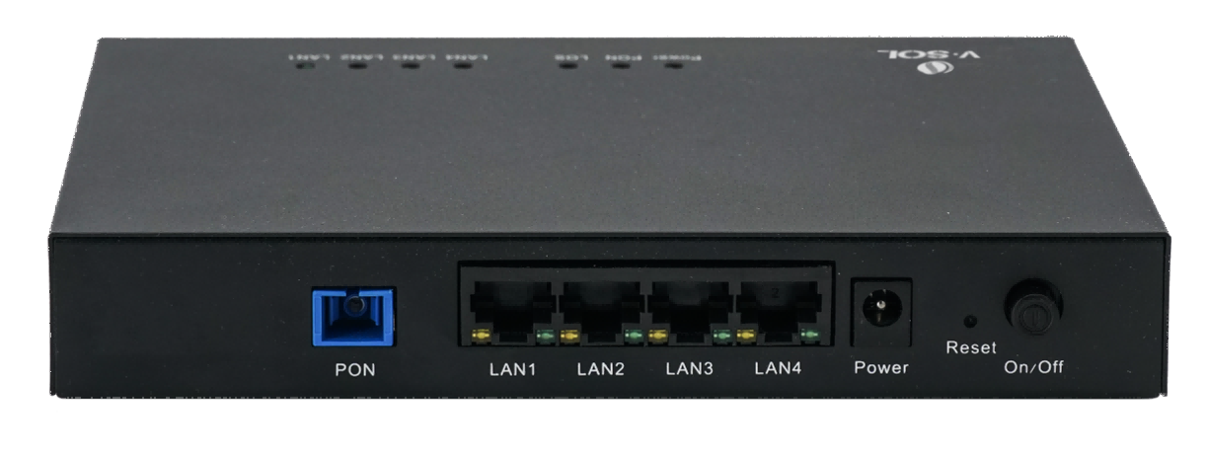
V2820D-1G3FPS XPON POE ONU
XPON+1×GE(POE+)+3×FE(POE+)
Key Features:
XPON Dual Mode
GPON/EPON
Compatible
IEEE802.3at POE+
Max 30W per port
Bridge Access Mode
High
Cost-Effective
Introduction:
V2820D-1G3FPS(1×GE+3×FE XPON POE(PSE) ONT) is specially designed to meet the FTTH, SOHO and other access requirements of telecom operators. The ONT is based on a high-performance chip solution, supports XPON dual-mode, and also supports Layer 2/Layer 3 functions, providing data services for carrier-grade FTTH applications.
The four network ports of the ONT all support the POE function, which can supply power to IP cameras, wireless APs and other devices through network cables.
The ONT has high reliability, is easy to manage and maintain, and has QoS guarantees for various services. It complies with a series of international technical standards such as IEEE802.3ah and ITU-T G.984.
Application Chart:
IP Phone
IP Camera
WiFi AP
Device with PoE(PD)
Internet
OLT
V2820D
Devices without POE
NVR
Computer
4K HDTV
VSOL product datasheet | Updated: 09 -12- 2021 | Rev.1.2 | www.vsolcn.com

Slide 2
Hardware Parameter
Function Data
Dimension | 175mm×123mm×28mm（L×W×H）
Net weight | About 0.6kg
Operating condition | Temperature: -20℃～50℃ Humidity: 5%～90%（non-condensing）
Storage condition | Temperature: -30℃～60℃ Humidity: 5%～90%（non-condensing）
Power adapter | DC 48V/1A
Power supply | ≤48W
Interface | 1×XPON+1×GE(POE+)+3×FE(POE+)
Indicators | POWER,LOS,PON, LAN1～LAN4
O&M | Support OMCI(ITU-T G.984.x) Support CTC OAM 2.0 and 2.1 Support Web/Telnet/CLI
Uplink Mode | Bridging mode Compatible with mainstream OLTs
L2 | 802.1D&802.1ad bridging 802.1p CoS 802.1Q VLAN
Multicast | IGMPv2/v3 IGMP snooping
Interface Parameter
PON Interface | 1XPON port(EPON PX20+&GPON Class B+) SC single mode, SC/UPC connector TX optical power: 0～+4dBm RX sensitivity: -27dBm Overload optical power: -3dBm(EPON) or -8dBm(GPON) Transmission distance: 20KM Wavelength: TX 1310nm, RX1490nm
User Interface | PoE+, IEEE 802.3at, Max 30W per port 1*GE+3*FE Auto-negotiation,RJ45 connectors Configuration of the number of MAC addresses learned Ethernet port-based VLAN transparent transmission and VLAN filtering
Ordering Information:
Product Name | Product Description | Accessories
V2820D-1G3FPS | 1*GE(POE+)+3*FE(POE+) | AC-DC power adaptor: DC48V/1A
Official Website: https://www.vsolcn.com/ E-mail: sales@ftthcpe.com support@ftthcpe.com

