Slide 1

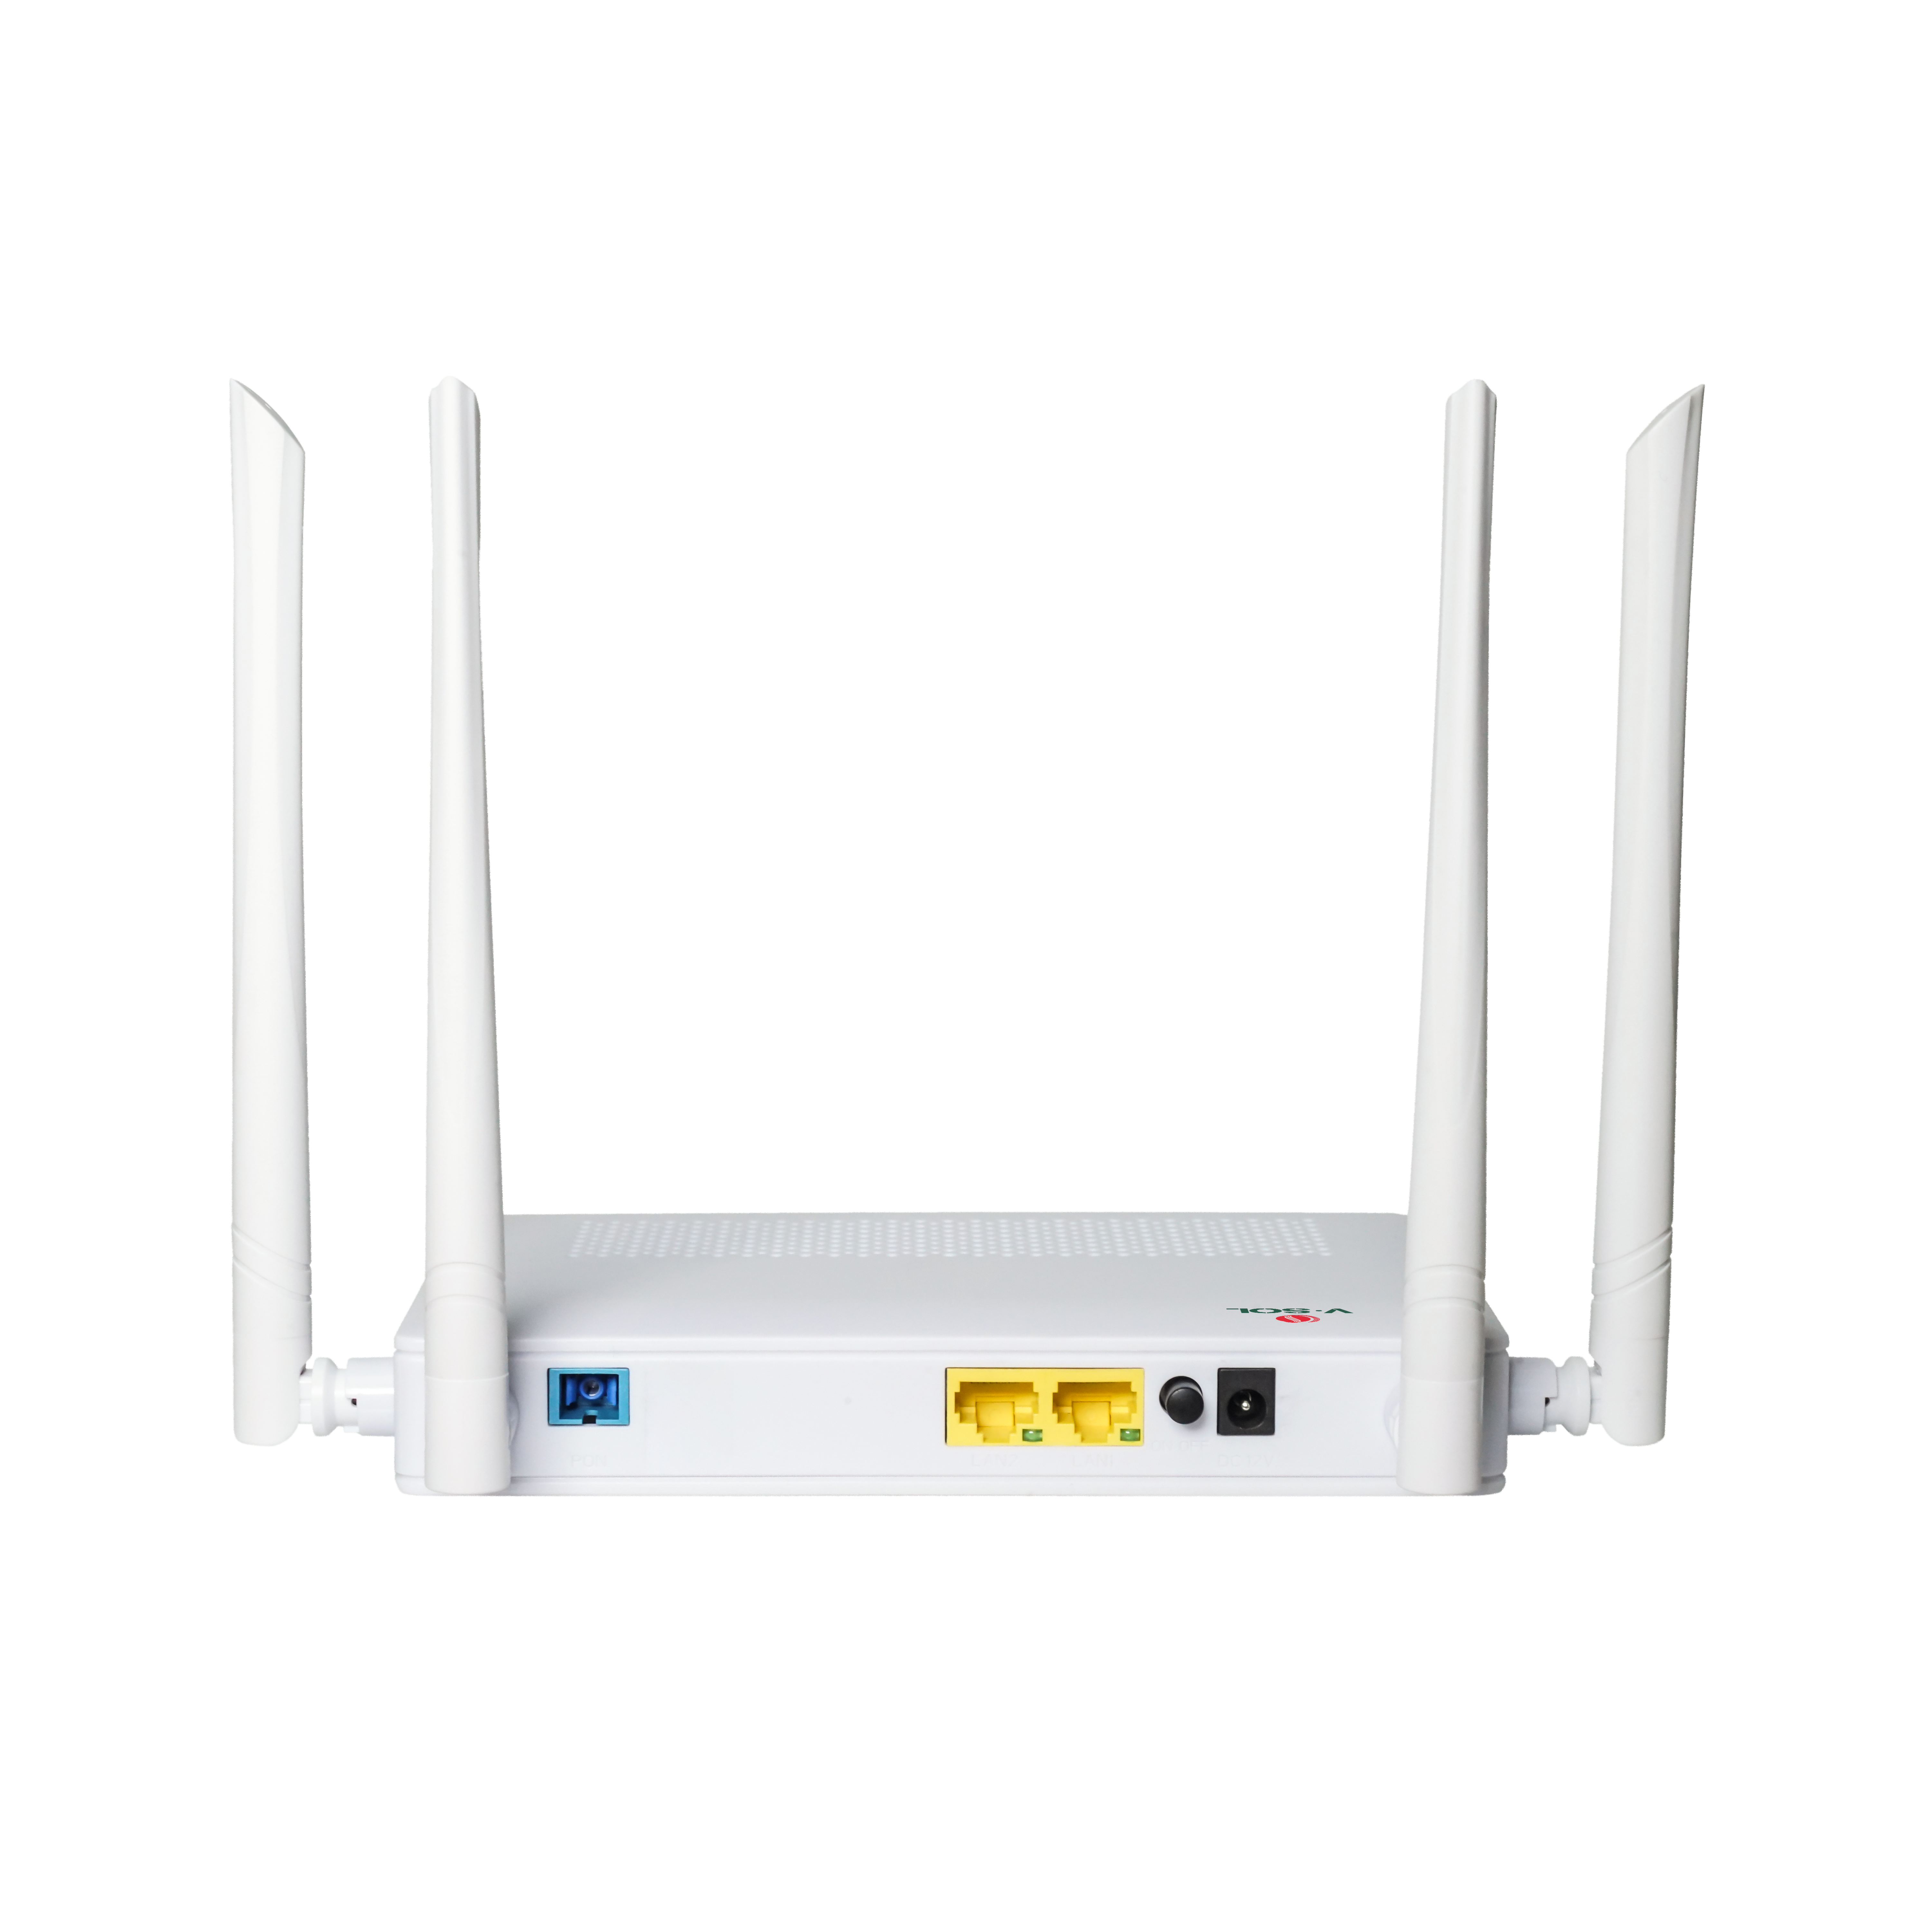














V2802DAC
With FEM
1*XPON+2GE+WiFi5 ONT
Key Features:
XPON Dual Mode
Auto-EPON/GPON Mode
WiFi5 Dual Band 1200Mbps
EasyMesh
IPv4/IPv6
Dual Stack
WiFi-FEM module
Introduction:
V2802DAC (2GE+WiFi5 XPON ONT) is designed to meet the FTTH requirements of fixed network operators. The ONT is based on a high-performance chipset (Realtek) technology solution, supporting IEEE802.11b/g/n/ac WIFI technology and other Layer 2/Layer 3 functions. This ONU has a FEM module, which can improve the transmission power and reception sensitivity of WIFI, making the coverage of WIFI larger. In addition, the ONT supports the OAM/OMCI protocol, and we can configure or manage various services of the ONT on the VSOL OLT.
The ONU has high reliability and is easy to manage and maintain. It has QoS guarantees for different services. It complies with the China Telecom CTC2.1/3.0 and international technical standards such as IEEE802.3ah, ITU-T G.984, etc.
Application Chart:
FEM Chipset
WLAN
SC/UPC
Internet
OLT
Splitter
Smart phone
12V DC
PC
IPTV
VSOL product datasheet | Updated: 24 -11 - 2021 | Rev.2.0 | www.vsolcn.com

Slide 2
Hardware Parameter
Function Data
Dimension | 178mm×120mm×30mm(L×W×H)
Net weight | 0.3KG
Operating condition | Operating temp: 0 ~ +55°C Operating humidity: 10 ~ 90% (non-condensing)
Storing condition | Storing temp: -30 ~ +60°C Storing humidity: 10 ~ 90% (non-condensing)
Power adapter | DC 12V,1.0A, external AC-DC power adaptor
Power supply | ≤12W
Interface | 2GE+WiFi5
Indicators | PWR, PON, LOS, 2.4G, 5G
O&M | OAM/OMCI,Telnet,WEB,TR069 Support full management of HGU functions by VSOL OLT
Connect Mode | Support bridge, router & bridge/router mixed mode
QoS | Support 4 queues Support SP, WRR, 802.1P and DSCP
Data Service Functions | • Full speed non-blocking switching • 2K MAC address table • 8 full range VLAN ID • Support VLAN tag, untag, transparent, trunk, translation mode • Integrated port monitoring, port mirroring, port rate limiting, port SLA, etc • Support auto polarity detection of Ethernet ports (AUTO MDIX) • Support IGMP v1/v2/v3 snooping/proxy and MLD v1/v2 snooping/proxy
Wireless | Integrated 802.11b/g/n/ac • Authentication:WEP/WAP-PSK(TKIP)/ WAP2-PSK(AES) • Modulation type:DSSS,CCK and OFDM • Encoding scheme:BPSK,QPSK,16QAM and 64QAM Easymesh
L3 | IPv4, IPv6 and IPv4/IPv6 dual stack DHCP/PPPOE/Static Static route, DHCP Server NAT/DMZ/DDNS/Virtual Server
Security | Support Firewall Support Mac filter Based on MAC or URL Support ACL
Interface Parameter
PON interface | 1XPON port(EPON PX20+ & GPON Class B+) SC single mode, SC/UPC connector TX optical power: 0～+4dBm RX sensitivity: -27dBm Overload optical power: -3dBm(EPON) or -8dBm(GPON) Transmission distance: 20KM Wavelength: TX 1310nm, RX1490nm
WIFI interface | Compliant with IEEE802.11b/g/n/ac 2.4GHz: 2.4000-2.4835GHz; 5.0GHz: 5.150-5.825GHz WiFi:2.4GHz 2×2, 5.8GHz 2×2, 5dBi antenna, rate up to 1.167Gbps,Multiple SSID TX power: 2.4GHz: 23dBm; 5GHz: 27dBm RX power: 2.4GHz: HT40-MCS7 -72dBm, 5GHz: VHT80 MCS9 <-63dBm
LAN interface | 2*GE, Auto-negotiation RJ45 connectors
Ordering Information:
Product Name | Product Description | Accessories
V2802DAC | 2GE+WiFi5 | AC-DC power adaptor: DC12V/1.0A
Official Website: https://www.vsolcn.com/ E-mail: sales@ftthcpe.com support@ftthcpe.com

